Slide 1
Network Devices

Slide 3
Contd…
Network Devices are various hardware devices that are used to connect computers,printers etc to a network.
They are also called as Networking Hardware or Network Equipment.
What is the work of Network Devices??
These devices help to transfer data fast ,secure on a correct way on a same or different network.
Which of these devices have specific purpose.

Slide 4


Slide 5
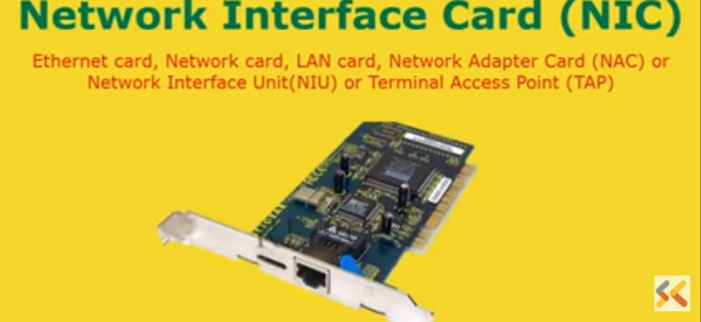
For any machine to connect with the network.We need either Network interface card (or) Wifi Card

Slide 6
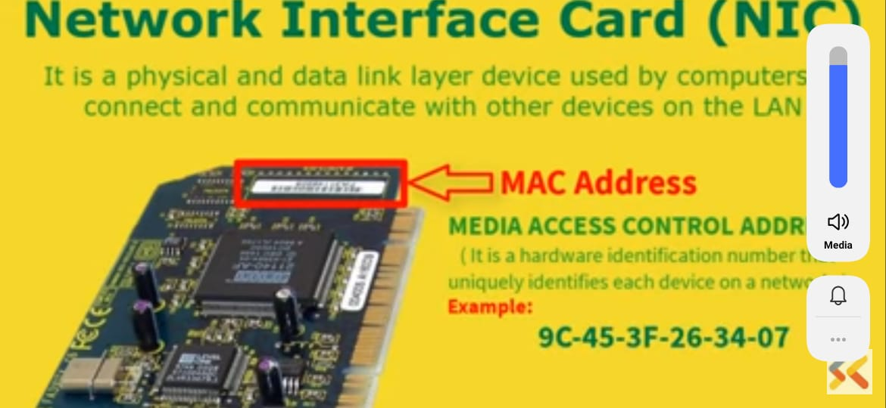
It is a physical and data link layer device used by the computers to connect and communicate with other devices on the LAN.
This physical address is called as MAC or (Media Access control Address) .It is a 6 byte unique identification address.so it will uniquely identifies each device on a network.

Slide 7
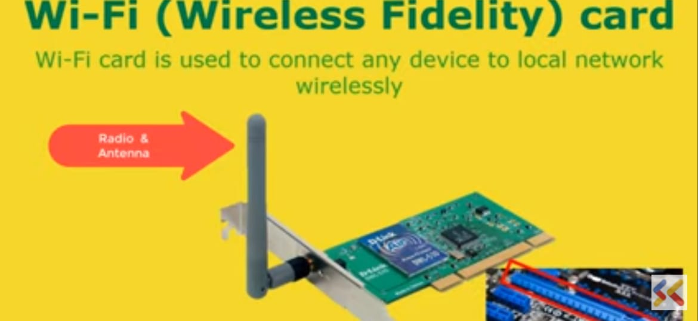
Wifi Technology is used to achieve wireless connection to any network.
They have built in wireless radio and antenna.
Most common card that is PIC Express wifi card..

Slide 8
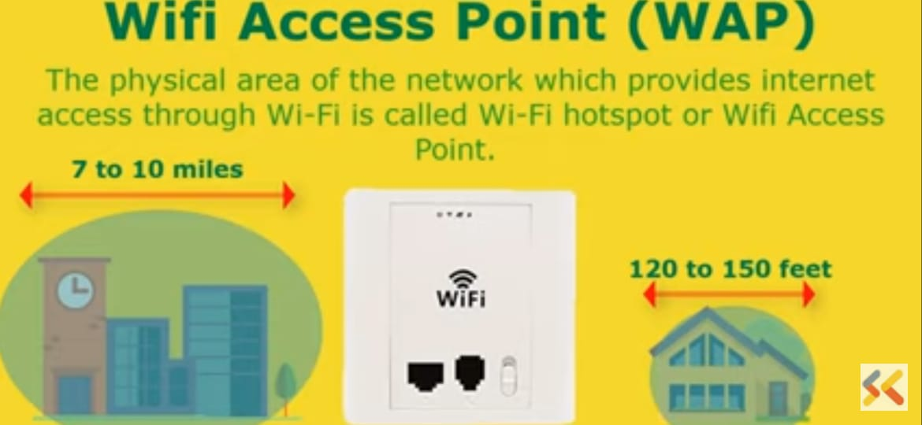
There can be the limit of no of computing devices that can be connect with the network.

Slide 9
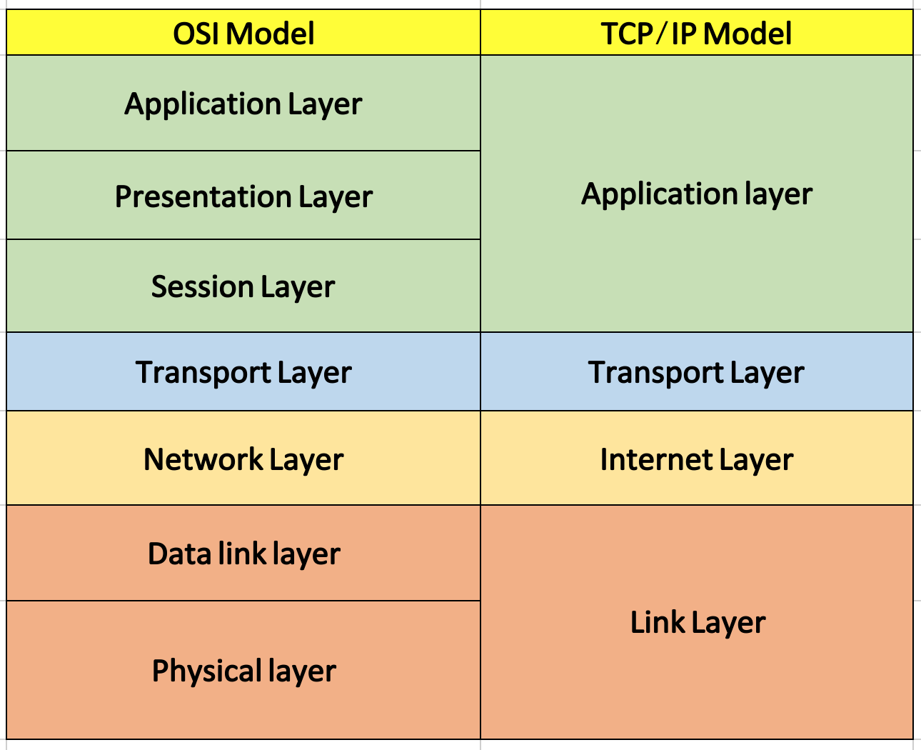

Slide 10
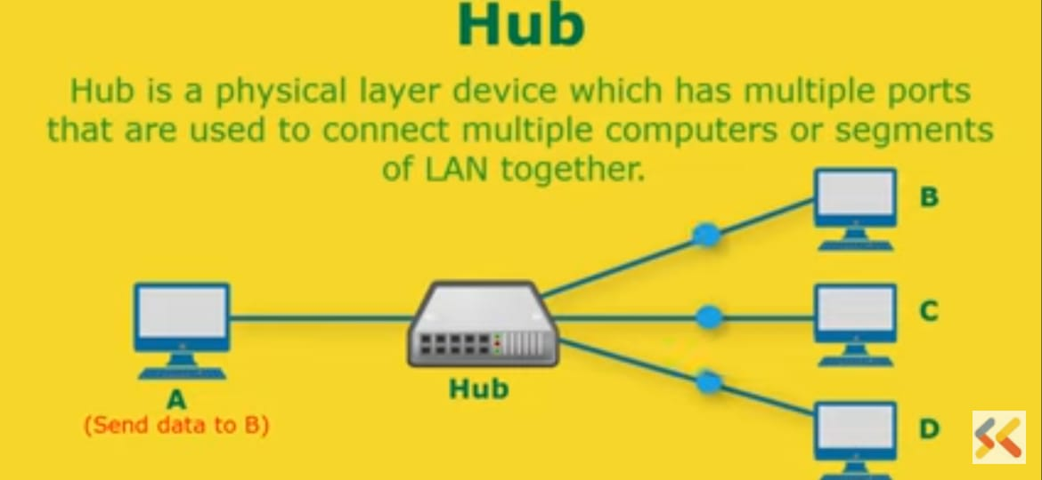

Slide 11
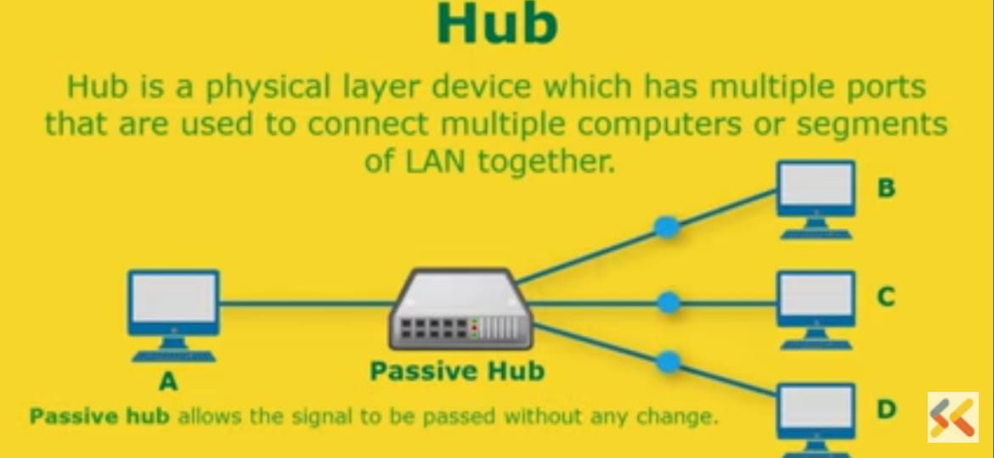
Passive Hub-It allows the signal to be passed without any change in the data.

Slide 12
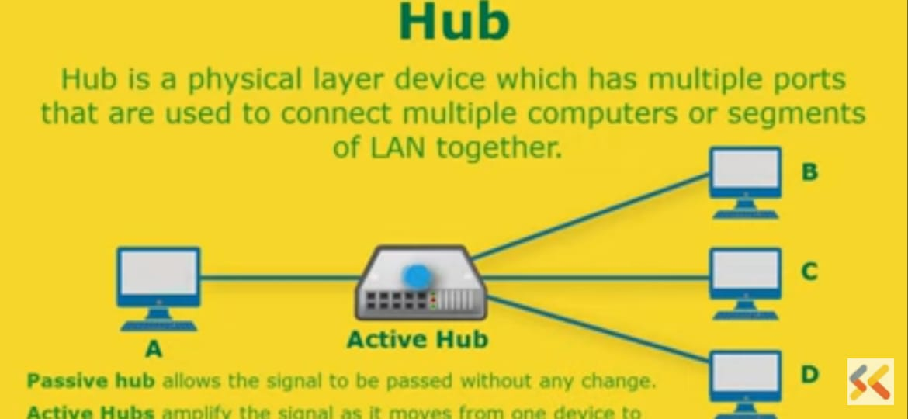
Active Hub-It amplify the signal as it moves from one device to another.That helps to extend the range of the signal without using repeater.

Slide 13


Slide 14


Slide 15


Slide 16
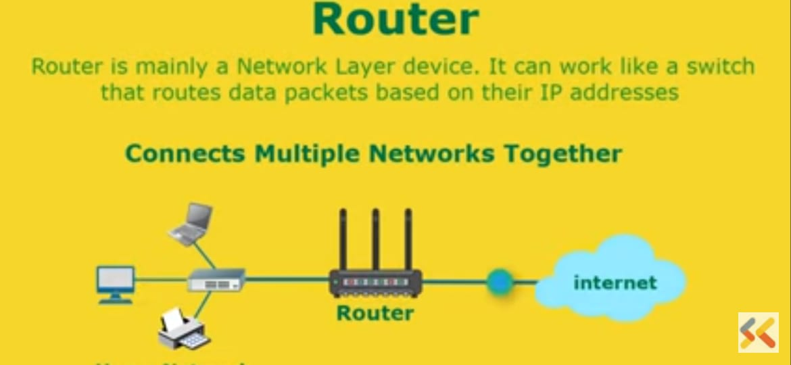

Slide 17
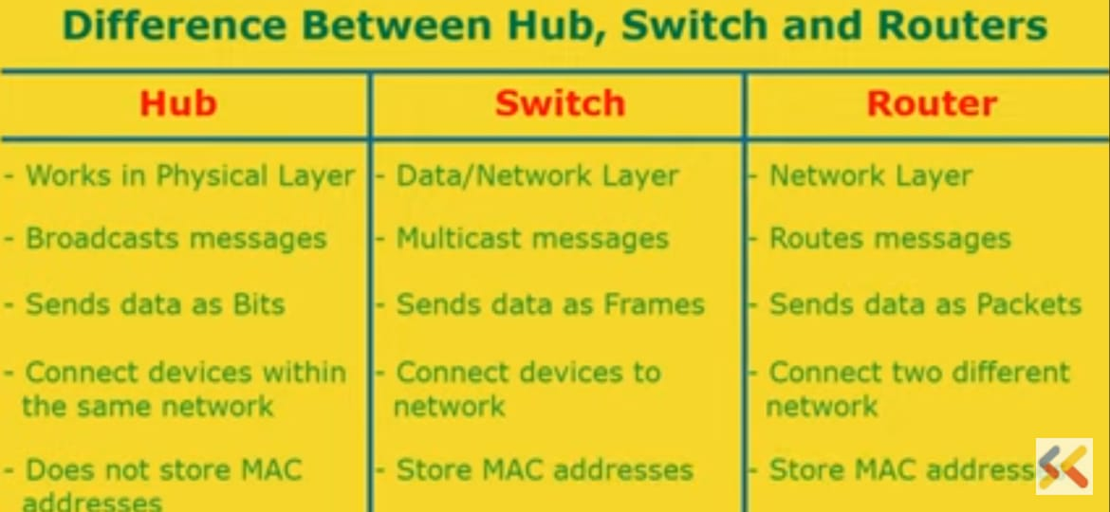

Slide 18


Slide 19
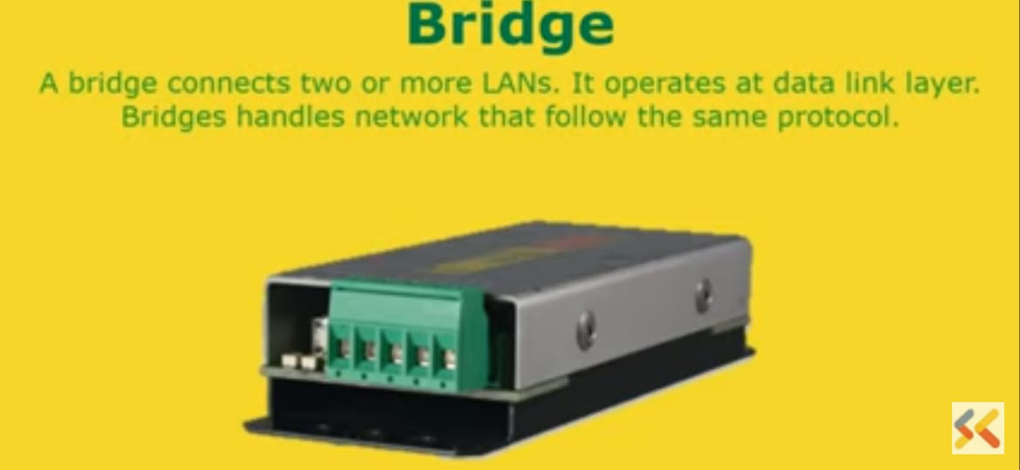

Slide 20
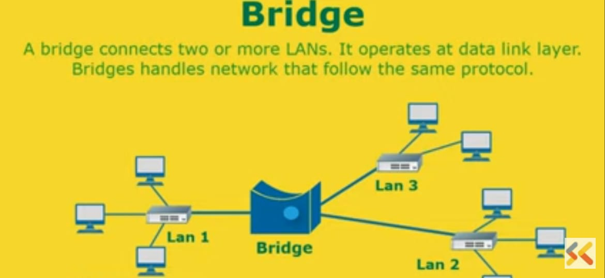

Slide 21
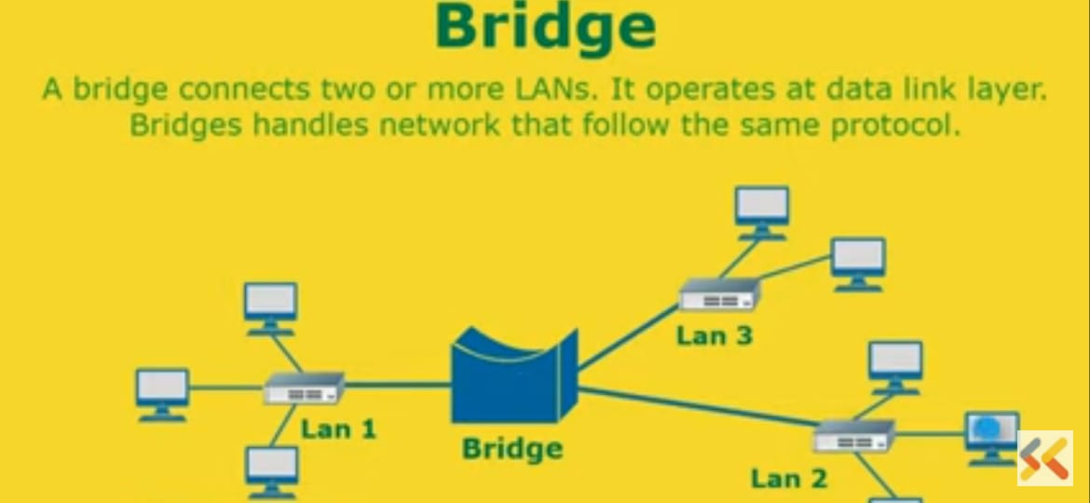
Function:
Filtering
Forwarding
Blocking

Slide 22
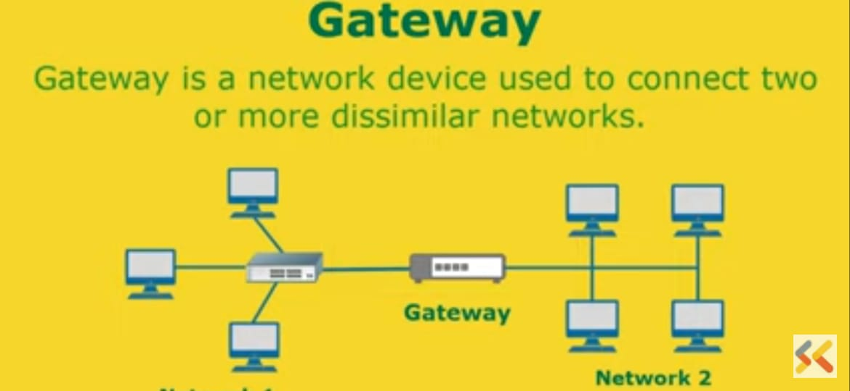
For large enterprise This computer can be act as a proxy server,Firewall or marvel protection

Slide 23
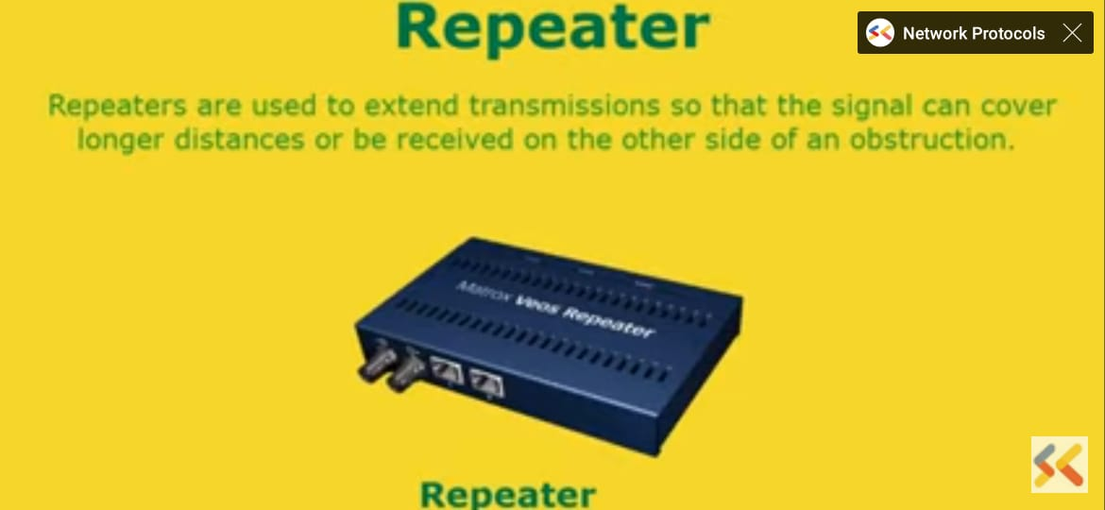
Repeaters

Slide 24
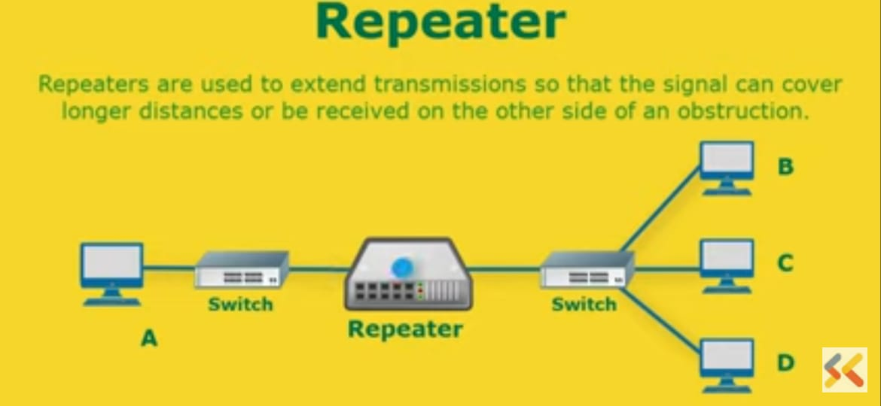

Slide 25
Modem…
Modem is a device which allows a computer to send and receive data over telephone lines or cable connections.
This shift of digital data into analog data and back again allows two computers to “speak” with one another called modulation/demodulation,this transformation of signals is how the modem received its name.
Internal modems-The modems that are fixed within the computer.
External modems-The modems that are connected externally to a computer as other peripherals are connected.

Slide 26
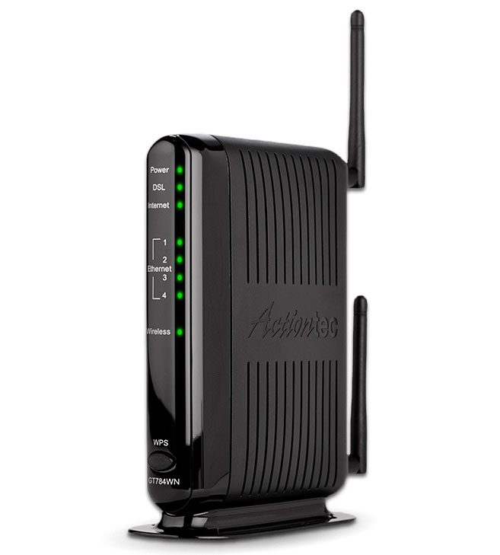
Contd….
A modem is a computer peripheral that allows you to connect and communicate with other computers via telephone lines.
Modulation is the process of sending data on a wave,3 types of modulation techniques are
AM(Amplitude Modulation)
FM(Frequency Modulation)
PM(Phase Modulation)

Slide 27
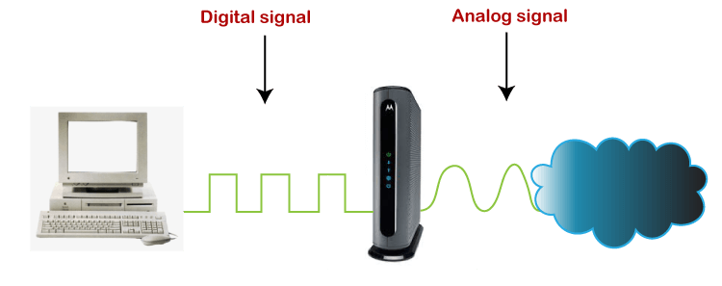
For eg:

Slide 28
RJ-45
RJ 45-(Registered Jack-45) It is an eight wire connector,which is commonly used to connect computers on the LAN.LAN especially Ethernets.(Ethernet is a LAN archiecture developed by Xerox Corp with DEC and Intel.IT uses either a bus or star topology and supports data transfer rates upto 10 Mbps)

Slide 29
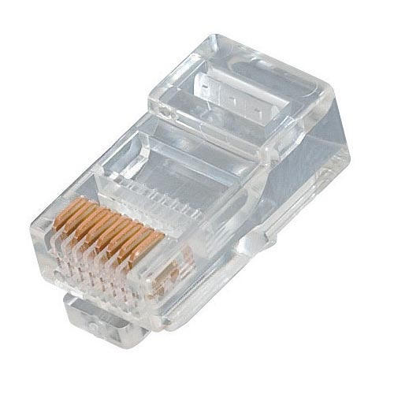
RJ-45(Registered JaCK-45)

Slide 30
RJ-45 connector is very much similar to standard telephone connector(RJ-11 connector) but it is wider than RJ-11 as it houses eight wires instead of four,RJ-45 connectors are used to connect computers in Ethernet LANs

Slide 31
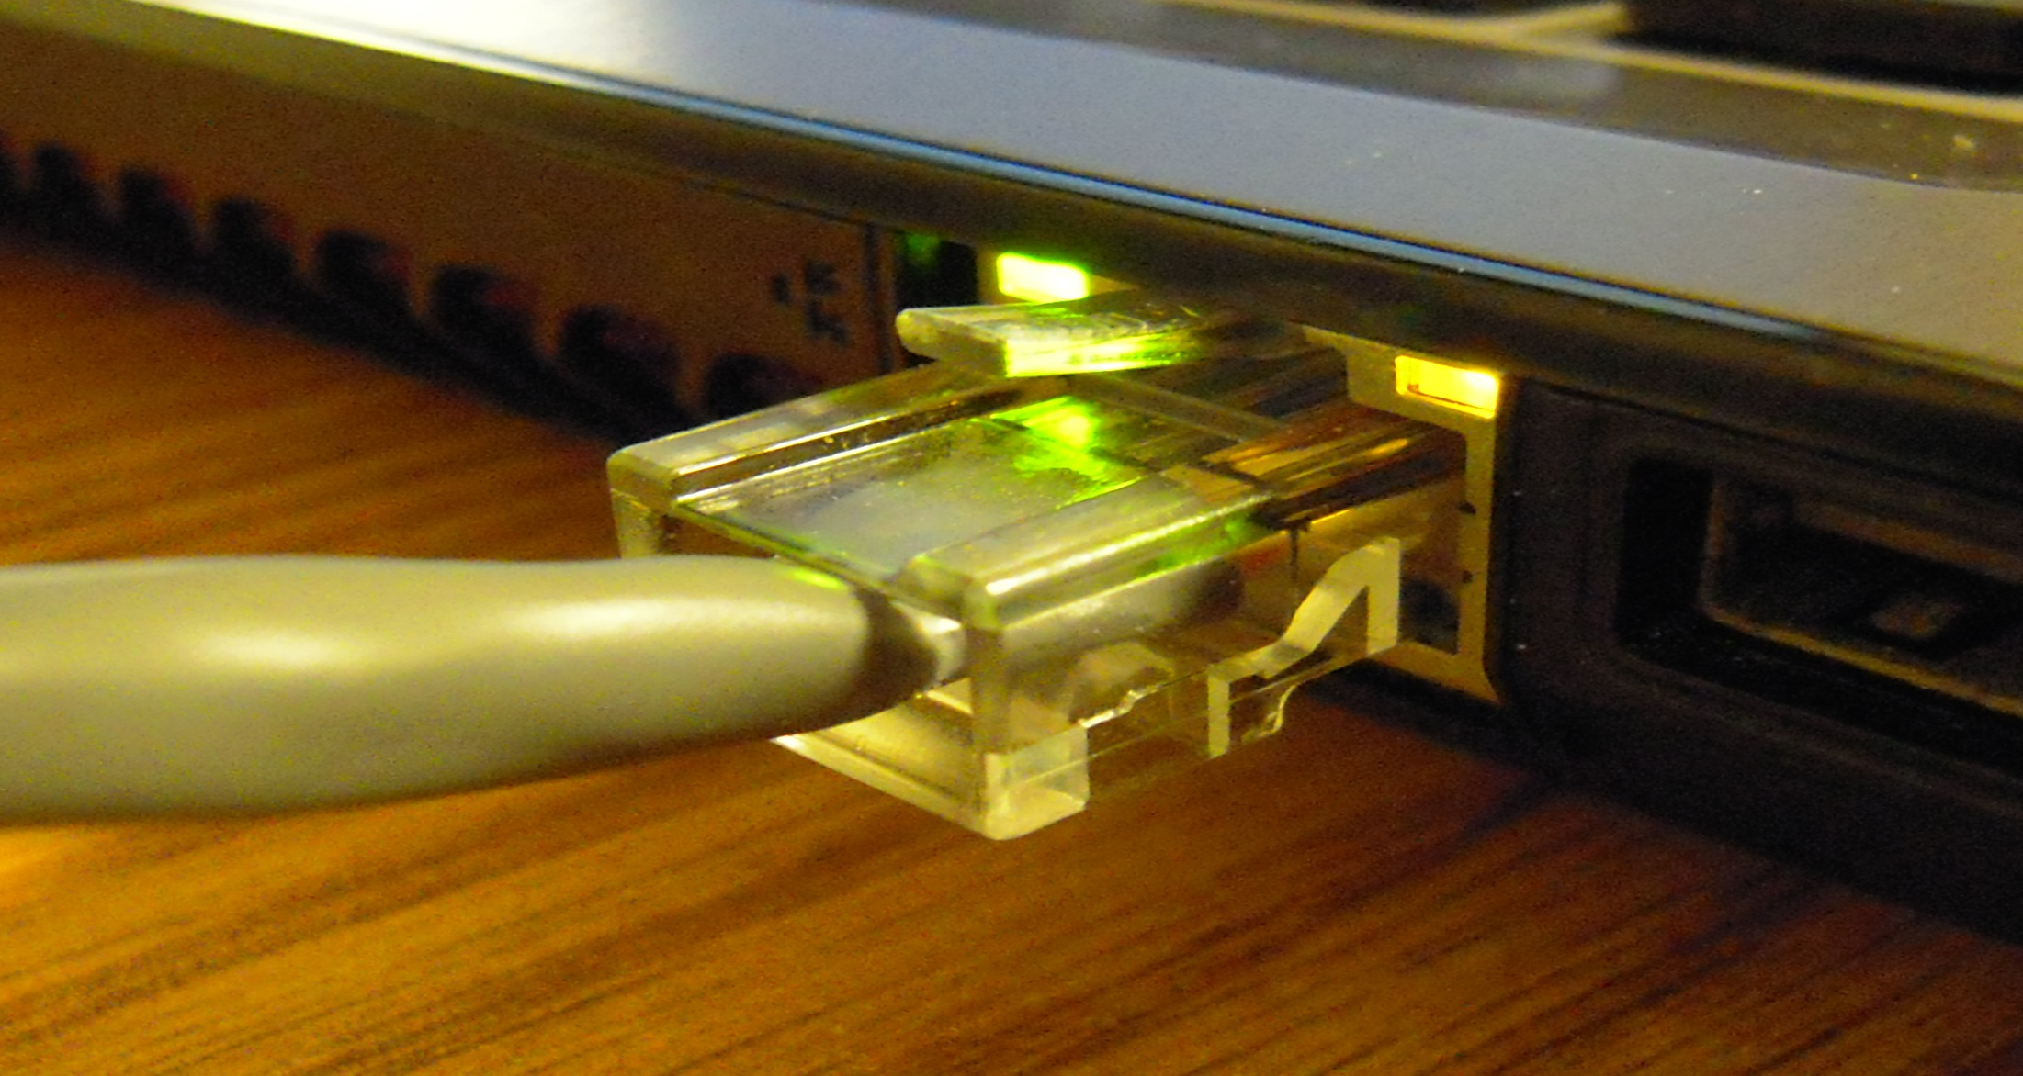
Ethernet
Ethernet is a family of wired computer networking technologies commonly used in local area networks (LAN), metropolitan area networks (MAN) and wide area networks (WAN).

